Slide 1
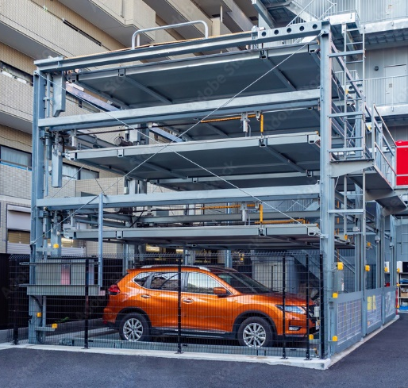
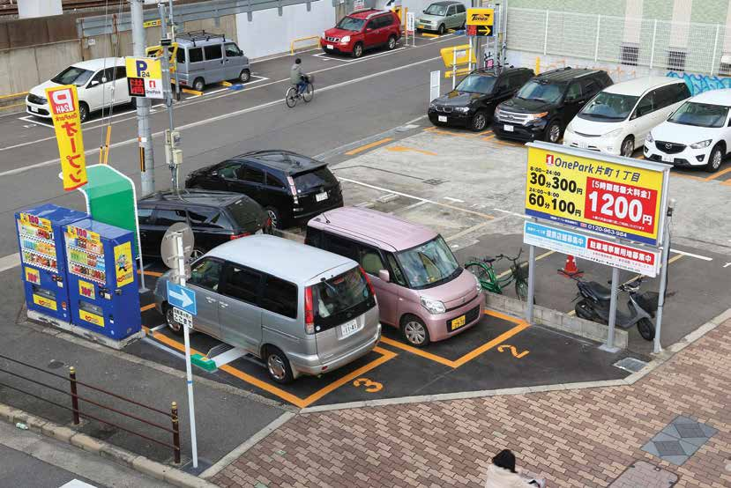
Car Parking Laws at Japan

Slide 2
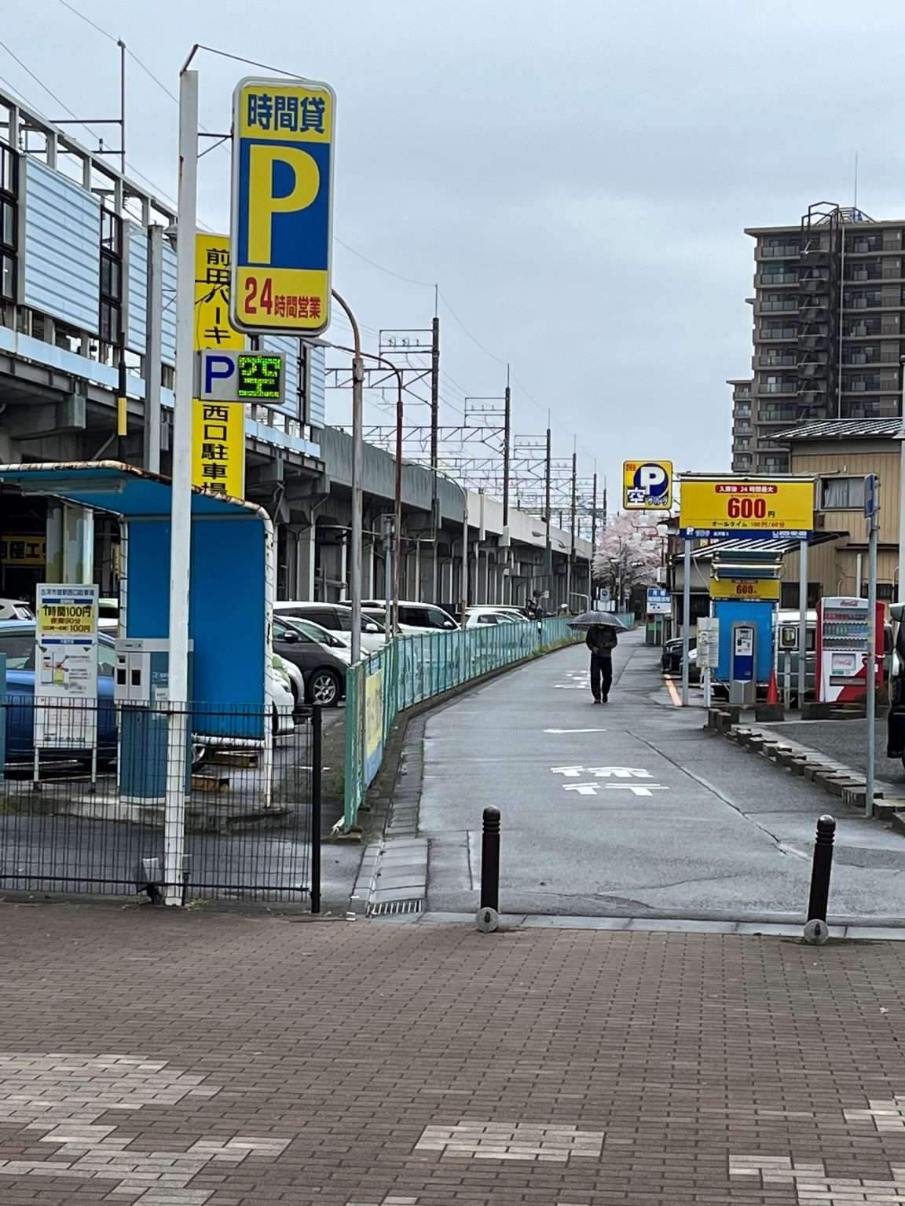
Parking Law of 1957 :
On street Parking Restrictions
On-street parking is typically not allowed unless expressly permitted.
On-street parking is permitted where there are parking signs and designated spots.
On streets with parking meters, parking is allowed for a limited time, often up to an hour. To park legally, you must park in the designated spot, pay at the meter, and display the ticket behind your windshield
(Example with Parking Signs)

Slide 3
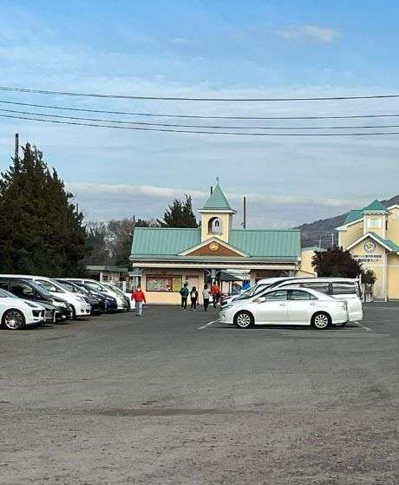
Parking Law of 1957 :
Mandatory Parking Spaces for Buildings
Under Article 20 of the 1957 Parking Law, local governments can establish ordinances requiring those who build, renovate, or enlarge large-scale buildings to provide parking spaces based on the specific land uses.
(Example of Parking Space)

Slide 4
Parking Law of 1957 :
Registered commercial car parks
Under Article 12 of the 1957 Parking Law, Owners of commercial car parks with over 500 square meter of space must furnish information to their local government, including the location, size, any structure, and other relevant data.
Till March 2013, there were 1,661,432 reported parking spaces in registered commercial car parks.
(Example of Commercial Parking Space)
(K.W. Axhausen, M. Chikaraishi and H. Seya, Parking-Learning from Japan, December 2015)

Slide 5
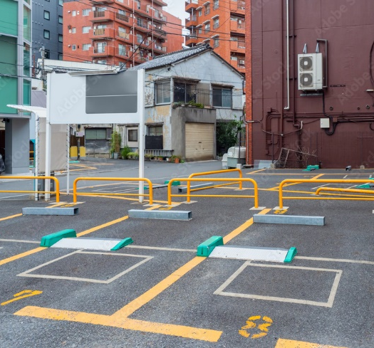
Parking Law of 1957 :
Parking development zones
Local governments may establish parking development zones within designated city planning areas under Article 8 of the City Planning Act and Article 3 of the Parking Law.
Till March 2013, 130 local governments had established 170 parking development zones in their urban plans, and 118,477 parking spaces had been built.
(Example of Parking development zone)
(K.W. Axhausen, M. Chikaraishi and H. Seya, Parking-Learning from Japan, December 2015)

Slide 6
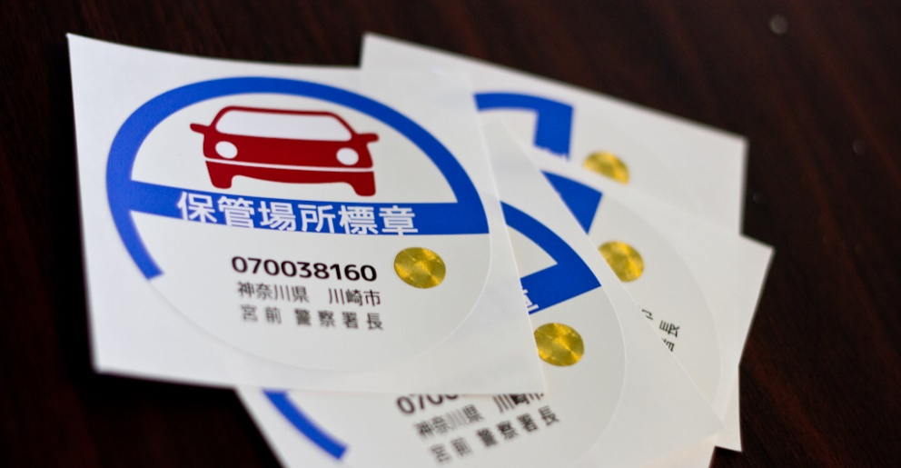
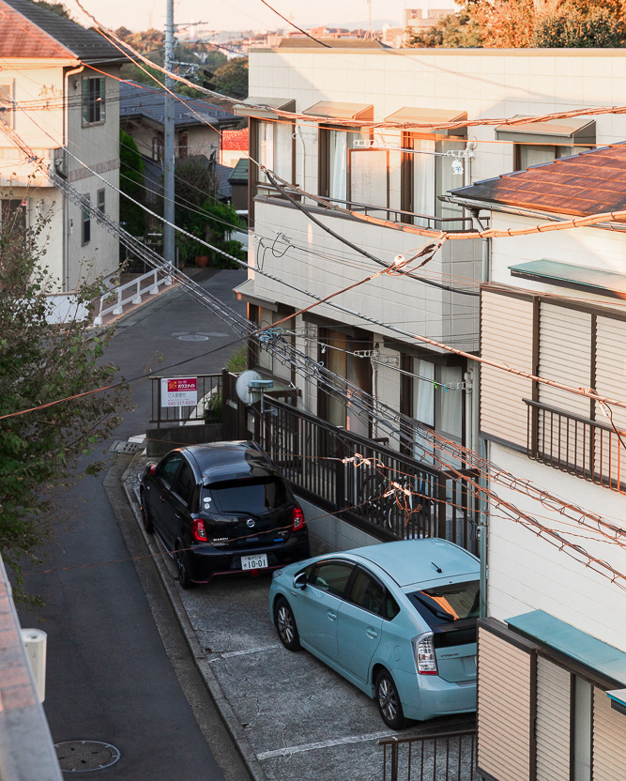
Motor Vehicle Storage Act, 1962 :
The "Motor Vehicle Storage Act of 1962," also known as the "Garage Act”.
requires vehicle owners in Japan to possess a "garage certificate" called as "Shako shomei sho" to register their car.
This certificate proves the owner has access to off-street parking within 2 km of their home or workplace.
The aim of this act is to prevent streets from being clogged with parked vehicles.
(Example of Parking Space)

Slide 7
Act on Special Measures Concerning Urban Reconstruction (April 2012) and the Low Carbon City Act (December 2012).:
In particular, obligatory car parks still need to be provided on the same parcels as under the current Parking Law, but exceptions can be made under the new acts.
Such as, local governments can ask property owners/developers to build parking spaces on the fringe of the CBD instead of providing them on their own parcels

